Slide 1
Networking Basics
Course Code: 3116
Course Title: Computer Networks
Dept. of Computer Science
Faculty of Science and Technology
Lecturer No: | 1 | Week No: | 1 | Semester:
Lecturer: | Dr. Mehedi Hasan; mmhasan@edu.com

Slide 2
Lecture Outline
Overview of TCP/IP Protocol Suite
Connecting Devices
Repeater
Hub
Bridge
Switch
Bridge
Collision domain and Broadcast domain
Ethernet Standards
WLAN Standards

Slide 3
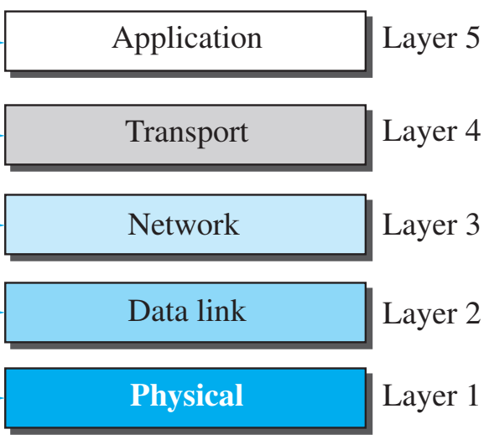
Overview of TCP/IP protocol suite
Application Layer
Only layer which interacts with users applications
Takes data from users in sending end and provide the data to user in the receiving end.
Protocols include HTTP, DNS, FTP, SMTP.
Implemented in source and destination devices only
Fig. 1Layers of TCP/IP protocol suites

Slide 4
Overview of TCP/IP protocol suite
Transport Layer
gets the message from the application layer, encapsulates it in a segment and sends it to transport layer.
Message delivery can be reliable but slow (TCP) or unreliable but fast (UDP)
Provide port addressing to application layer programs
Perform error control, flow control and congestion control
Fig. 1Layers of TCP/IP protocol suites

Slide 5
Overview of TCP/IP protocol suite...
Network Layer or Internet Layer
Require for communication between multiple networks
Introduces IP address , perform routing and congestion control
Encapsulate segment into a packet (called IP datagram)
Used in end devices and network layer devices (Router, PC, Layer 3 switch, etc.)
Protocols include IP ICMP, RIP, EIGRP, OSPF etc.
Fig. 1Layers of TCP/IP protocol suites

Slide 6
Overview of TCP/IP protocol suite...
Data-link Layer
Require for communication inside a network
Introduces MAC address, perform error control and flow control
Encapsulating packet into frame
Used in all devices (PC, Router, Switch, Bridge) except hub & repeater
Protocols include ALOHA, CSMA, CSMA/CD, CSMA/CA
Fig. 1Layers of TCP/IP protocol suites

Slide 7
Overview of TCP/IP protocol suite….
Physical Layer
Accepts a complete frame from the Data Link layer and encodes it as a series of signals that are transmitted onto the local media.
Specifies transmission media
Network physical topology [1]
Fig. 1Layers of TCP/IP protocol suites

Slide 8
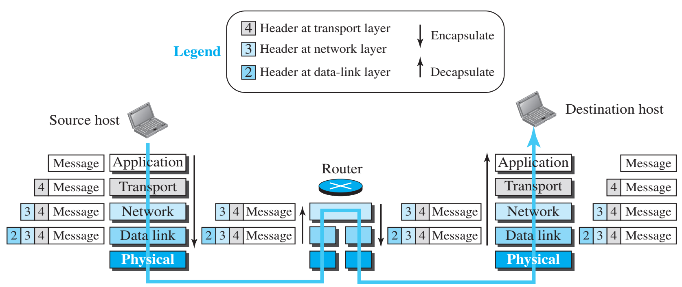
Overview of TCP/IP protocol suite….
Fig. 2 Encapsulation/Decapsulation

Slide 9
Connecting Devices
Repeater
Repeater
Layer 1 device that takes voltage from the line, amplifies the voltage, and sends it down the line [3].
Used to extend a network beyond the maximum length of the cable segment [2]
If there is any “noise” caused by electromagnetic interference on the wire, it will also amplify the noise and send it [3].
The use of three repeater in a row results in an unusable signal transmission because of extreme noise [3].
These devices are not in common use anymore; they have been replaced by hubs, bridges, and switches.

Slide 10
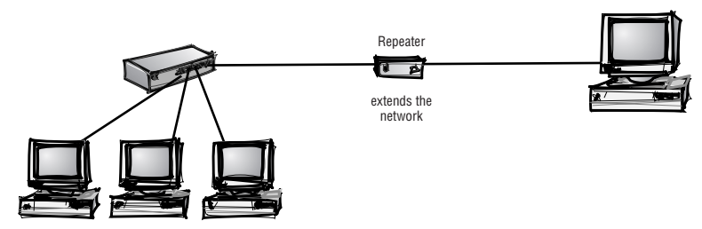
Connecting Devices….
Repeater
switch/hub/bridge
Fig. 3 Use of repeaters and switch/hub/bridge [2]

Slide 11
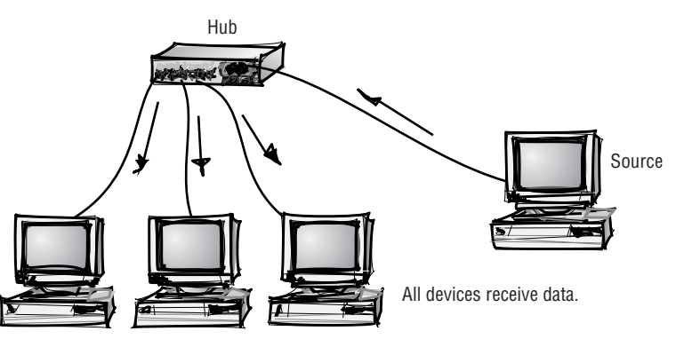
Connecting Devices….
Hub
Hub
A repeater with more than one output port.
Electrical signal comes through one port of the hub and gets amplified and sent out through all ports of the hub.
if you have a 10-Mbps hub and three devices are transmitting at the same time, each device gets one third of the bandwidth [5].
Fig. 4 Broadcasting of a Hub [2]
For a successful transmission, only one station can send data at a time.
More active ports cause more collision among signal, thereby resulting in lower data rate.
A layer 1 device [2] and is Used to connect devices of a single network

Slide 12
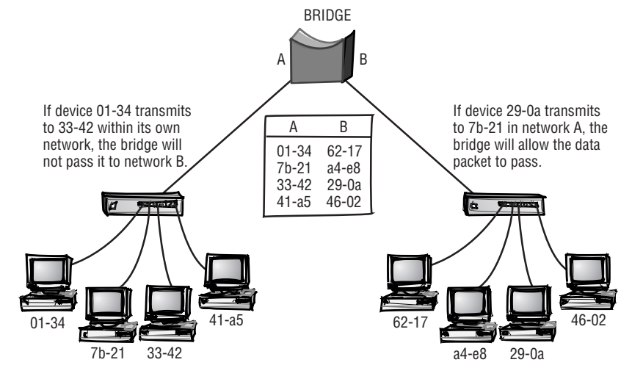
Connecting Devices….
Bridge
Bridge
A layer 2 device
Used to connect devices of a single network
It sends the received frame only to the intended destination based on the destination MAC address of the frame.
Better bandwidth usage [3].
Unlike hub, it has error detection capability
Limited ports (2-4, usually 2 ports)
Fig. 5 Filtering of a Bridge [2]

Slide 13
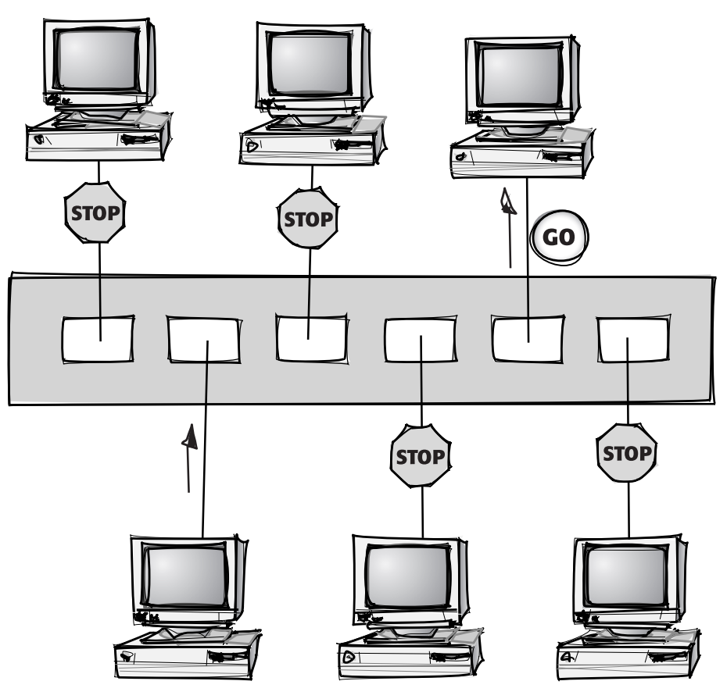
Connecting Devices….
Switch
Switch
A layer 2 device
Used to connect devices of a single network
Like a Bridge, it sends the received frame only to the intended destination based on the destination MAC address of the frame.
Unlike hub, it has error detection capability
Hundreds of ports( 2 to more than 100)
Frame forwarding decision is taken based hardware, hence it is faster than bridge [4].
If you have a 10-Mpbs switch with three devices connected to it, all three devices can use 10- Mbps of bandwidth. [5].
D
E
F
Frame to F
A
B
C
Fig. 6 Filtering of a Switch [2]

Slide 14
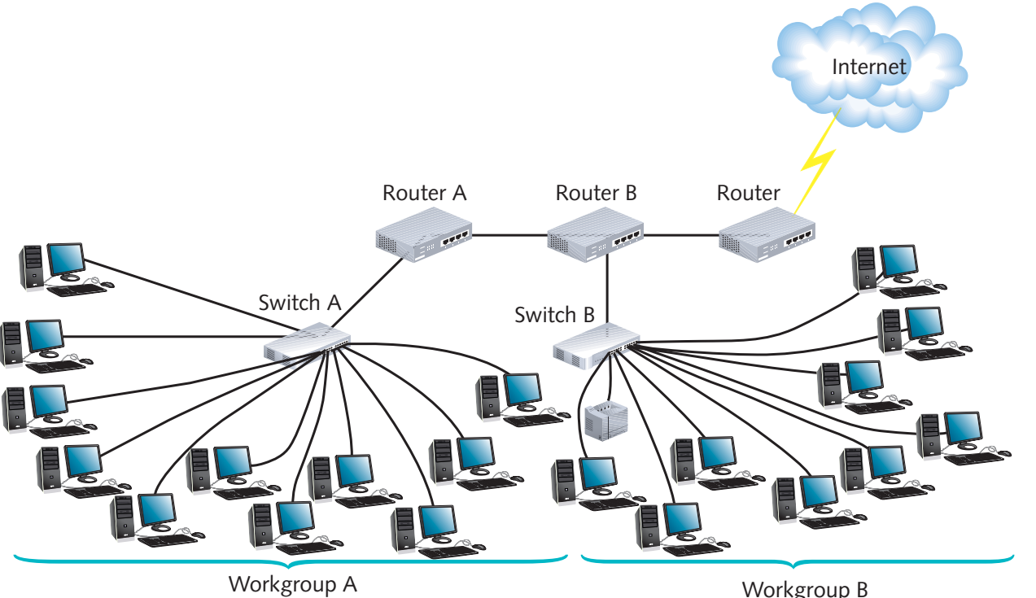
Connecting Devices….
Router
Router
A layer 3 device
Used to connect multiple networks
Connected networks can have different protocols and speed.
Forward packets based on destination IP address
Most intelligent connecting device
Can also be used to forward packet within a network
Slower than switch because of its routing protocol implementation
Fig. 7 Router connecting multiple
networks [6]

Slide 15
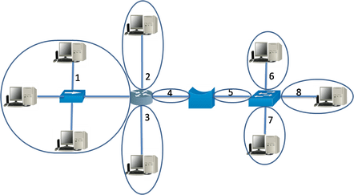
Collision Domain
The “collision domain” describes a network where packet collisions can occur when two devices on a shared network medium send packets simultaneously.
Hub: All ports belong to the same collision domain.
Bridge, Switch, Router: Each port belongs to a separate collision domain.

Slide 16
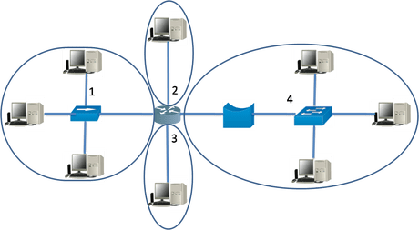
Broadcast Domain
All the devices in the broadcast domain can reach via broadcast at the data link layer.
A Broadcast Domain can receive any broadcast packet originating from any device within the network segment.
All ports of hub and switch belong to same broadcast domain but all ports of the router belong do different broadcast domain [9].

Slide 17
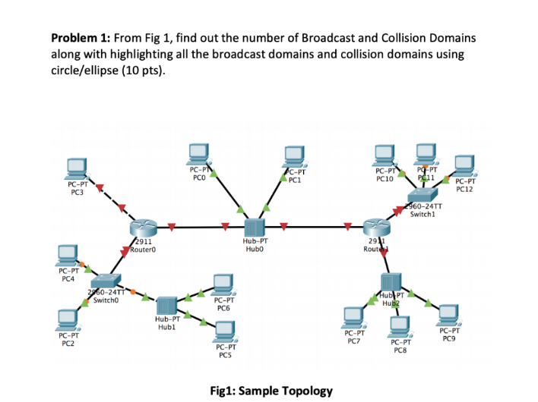
Problem

Slide 18
Ethernet Standards
TABLE I Ethernet Standard [7]
Speed | Common Name | Informal Standard Name | Formal Standard Name | Cable Type | Max. Length
10 Mbps | Ethernet | 10BASE-T | 802.3 | Cat3 | 100 m
100 Mbps | Fast Ethernet | 100BASE-T | 802.3u | Cat5 | 100 m
1000 Mbps | Gigabit Ethernet | 1000BASE-LX | 802.3z | Single mode fiber | 5000 m
 |  |  |  | 50-micron multimode fiber | 550 m
 |  |  |  | 62.5-micron multimode fiber | 440 m
1000 Mbps | Gigabit Ethernet | 1000BASE-T | 802.3ab | Cat5, Cat5e | 100 m
10 Gbps | 10 Gig bit Ethernet | 10GBASE-T | 802.3an | Cat6, Cat6a | 100 m

Slide 19
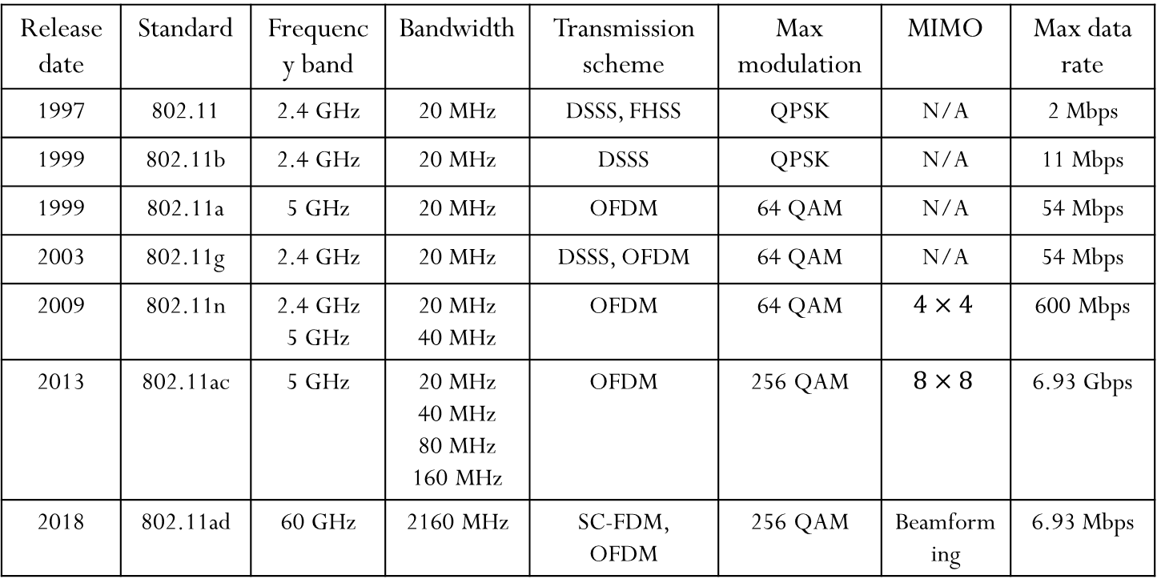
WLAN Standards
TABLE II WLAN Standard [8]
Release date | Standard | Frequency band | Bandwidth | Transmission scheme | Max modulation | MIMO | Max data rate
1997 | 802.11 | 2.4 GHz | 20 MHz | DSSS, FHSS | QPSK | N/A | 2 Mbps
1999 | 802.11b | 2.4 GHz | 20 MHz | DSSS | QPSK | N/A | 11 Mbps
1999 | 802.11a | 5 GHz | 20 MHz | OFDM | 64 QAM | N/A | 54 Mbps
2003 | 802.11g | 2.4 GHz | 20 MHz | DSSS, OFDM | 64 QAM | N/A | 54 Mbps
2009 | 802.11n | 2.4 GHz 5 GHz | 20 MHz 40 MHz | OFDM | 64 QAM | $$4×4$$ | 600 Mbps
2013 | 802.11ac | 5 GHz | 20 MHz 40 MHz 80 MHz 160 MHz | OFDM | 256 QAM | $$8×8$$ | 6.93 Gbps
2018 | 802.11ad | 60 GHz | 2160 MHz | SC-FDM, OFDM | 256 QAM | Beamforming | 6.93 Mbps

Slide 20
Connecting Devices….
Acronyms
DSSS: Direct sequence spread spectrum
FHSS: Frequency hop spread spectrum
OFDM: Orthogonal Frequency Division Multiplexing
SC FDM: Single carrier frequency domain multiplexing
QPSK: Quadrature phase shift keying
QAM: Quadrature amplitude modulation
MIMO: Multiple input multiple output
Beamforming: Technique of focusing a wireless signal towards a specific receiving device

Slide 21
References
[1] B. A. Forouzan, Data Communication and Networking, 5th ed., The McGraw-Hill Companies, Inc., USA, 2013, pp. 38-42.
[2] P. Ciccarelli and C. Faulkner, Networking Foundations, Sybex Inc., USA, 2004, pp. 160 –
165.
[3] D. Liu, Cisco CCNA/CCENT Exam 640-802, 640-822, 640-816 Preparation Kit, Syngress
Publishing, Inc., 2009, pp. 607-609.
[4] Difference between a switch and a bridge, https://geek-university.com/ccna/ differences-between-a-switch-and-a-bridge/, [Accessed: April. 22, 2020].
[5] D. Barrett and T. King, Computer Networking Illuminated, Jones and Bartlett Publishers,
Inc., USA, 2003, pp. 90-91.
[6] T. Dean, Network+ Guide to Networks, Course Technology, USA, 2013, pp. 270.
[7] W. Odom, Official Cert Guide CCNA 200-301 Volume 1, Pearson Education, Inc.,
2020, USA, p. 37.
[8] Wifi Standard Evolutions, https://www.grandmetric.com/2018/05/29/wi-fi-standards-evolution/, [Accessed: April. 30, 2020].
[9] Collision and broadcast domain, https://networkustad.com/2019/07/16/collision-and-broadcast-domains/, [Accessed: April. 30, 2020].

Slide 22
Recommended Books
Data Communications and Networking, B. A. Forouzan, McGraw-Hill, Inc., Fourth Edition, 2007, USA.
Computer Networking: A Top-Down Approach, J. F., Kurose, K. W. Ross, Pearson Education, Inc., Sixth Edition, USA.
Official Cert Guide CCNA 200-301 , vol. 1, W. Odom, Cisco Press, First Edition, 2019, USA.
CCNA Routing and Switching, T. Lammle, John Wily & Sons, Second Edition, 2016, USA.
TCP/IP Protocol Suite, B. A. Forouzan, McGraw-Hill, Inc., Fourth Edition, 2009, USA.
Data and Computer Communication, W. Stallings, Pearson Education, Inc., Tenth Education, 2013, USA.

